Slide 1


Energy Implications of Prompt Design in Edge-Based LLM Inference
Uttam Emmaniuel Dammu
Anderson College of Business and Computing, Regis University
MSDS 696 – Data Science Practicum II
Professor: Dr. Ghulam Mujtaba
Mentor: Dr. Kellen Sorauf
April 30, 2025

Slide 2
2. Problem & Goal
Prompt
Computation
Energy
Large Language Models (LLMs) require high computational resources.
Edge devices (e.g., Jetson Orin Nano) have limited power capacity.
Energy efficiency is critical for real-world deployment.
Moving from prompt design analysis on open and closed LLM’s to energy measurement in edge devices.
Does Prompt Design Affect
Energy Consumption during LLM inference?
Goal: Analyze how prompt styles affect tokens, latency and energy.

Slide 3

3. Dataset & Experimental Setup
3 Datasets
REPLIQA (2024-25) → Q/A
MultiHopQA (2025) → Reasoning
CCSum (2024) → Summarization
Inputs
20 input instances per dataset.
4 Prompt Styles
Concise
Total Runs
60 Inputs x 4 Styles = 240 Runs
Structured
Verbose
Chain-of-Thought
Each instance represents a single task (question or document).
3 Datasets
60 Input Instances
4 Styles
240 Runs
Device: Jetson Orin Nano
Metrics Collected: Tokens, Latency, Energy, Power

Slide 4
4. Data Collection & Experimental Pipeline
Built an automated pipeline that controls prompts, execution and metric logging across runs.
Prompt Design
Filtering failed runs & validating metric consistency
Model Inference (Ollama / LLM)
Metric Collection (Tokens, Latency, Power)
Energy Computation (Power → Joules)
Data Logging (CSV)
Aggregation & Analysis
Visualization & Modeling
Experiments automatically iterate across:
For each run, we record:
Prompt Styles
Input Tokens, Output Tokens
Latency
Energy & Power (via tegrastats)
Datasets
Each Configuration executed ~60 times for statistical reliability.

Slide 5
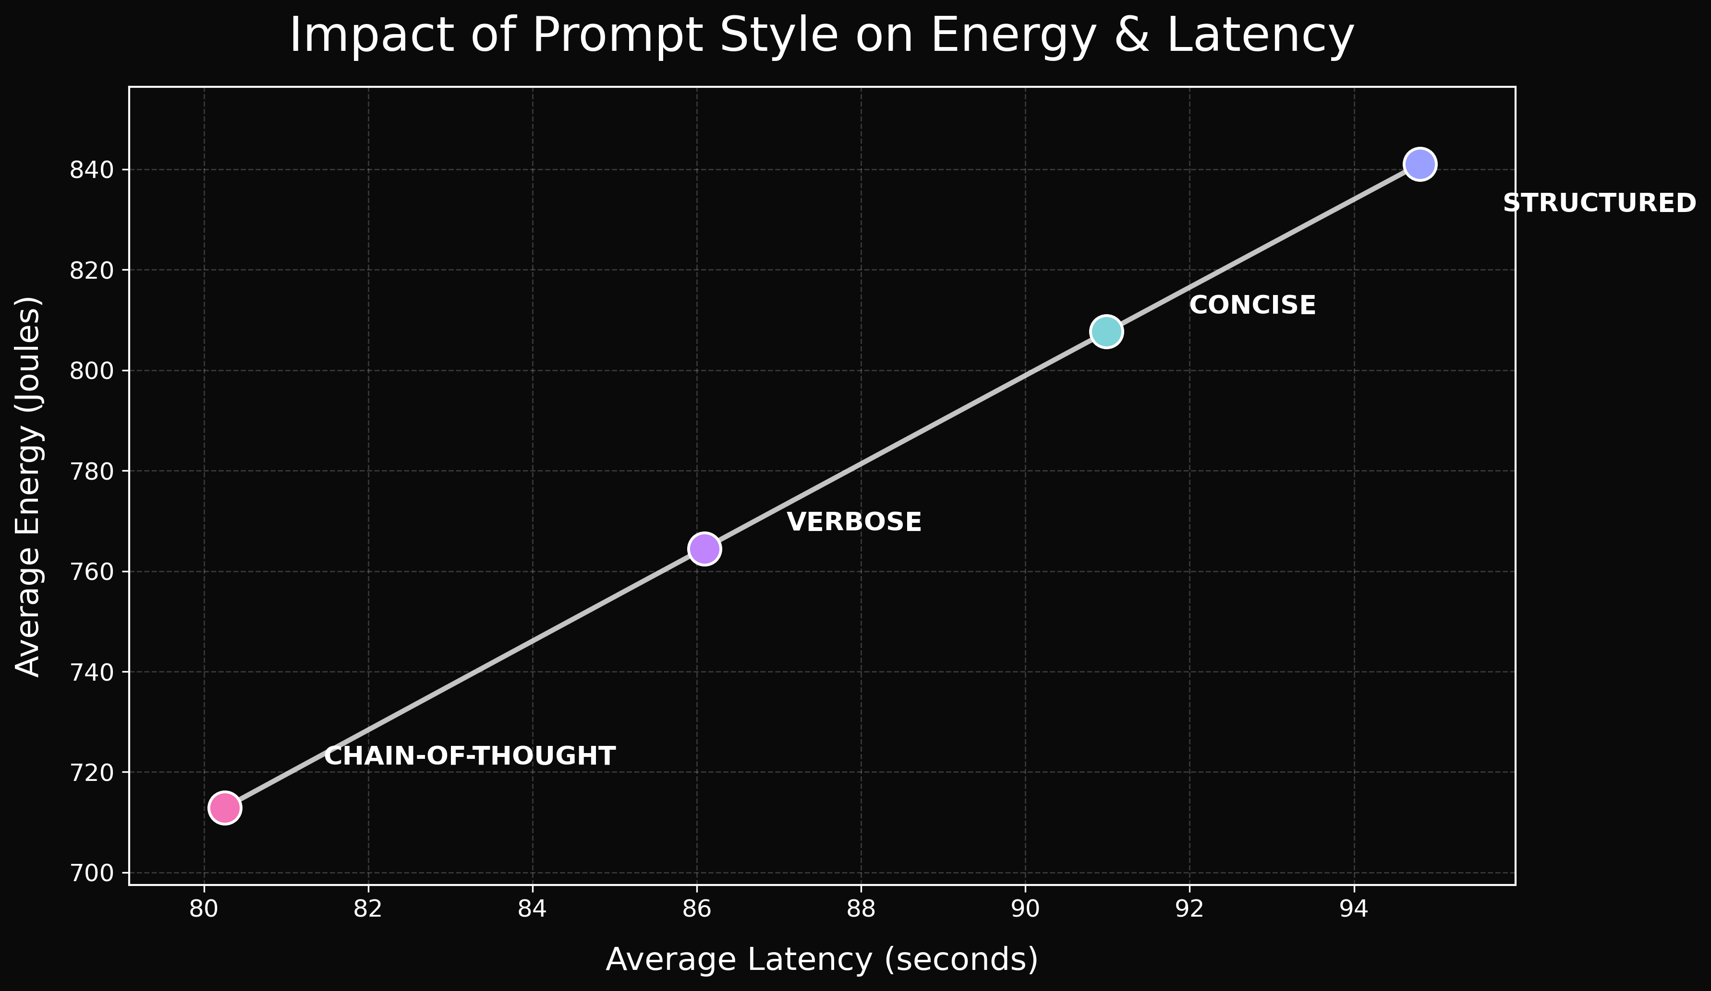
5. Impact of Prompt Style on Energy & Latency
Energy consumption scales linearly with latency across all prompt styles.
Structured prompts shows the highest consumption of energy followed by concise prompts.
Structured uses ~18% more energy than Chain-of-Thought.
Chain-of-thought prompts were unexpectedly more efficient in this setup.
Each point represents average across 60 runs per prompt style.

Slide 6
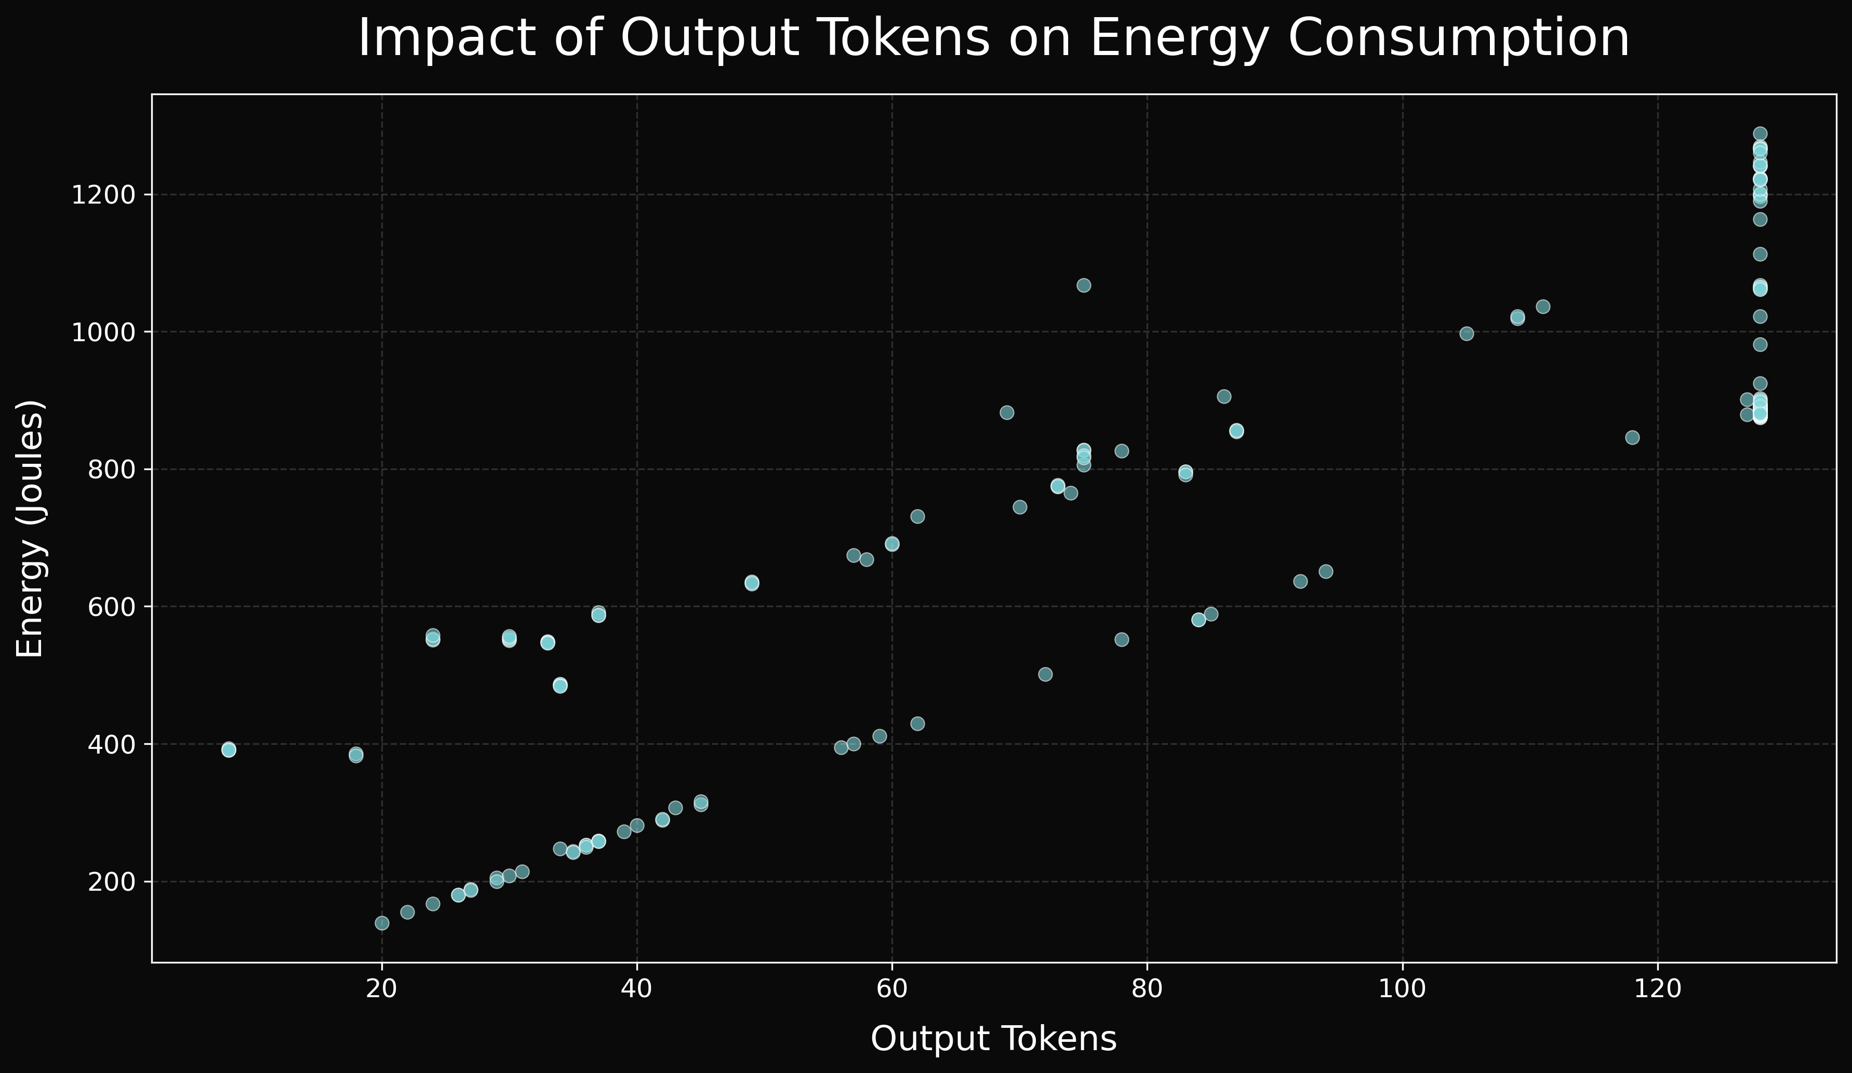
6. Impact of Output Tokens on Energy Consumption
Energy consumption increases with output tokens length.
Strong positive correlation (r ≈ 0.9).
Longer responses require more computation and latency.
Output tokens are the dominant driver of energy usage.
Each point represents an individual run out of a total of 240 runs.

Slide 7
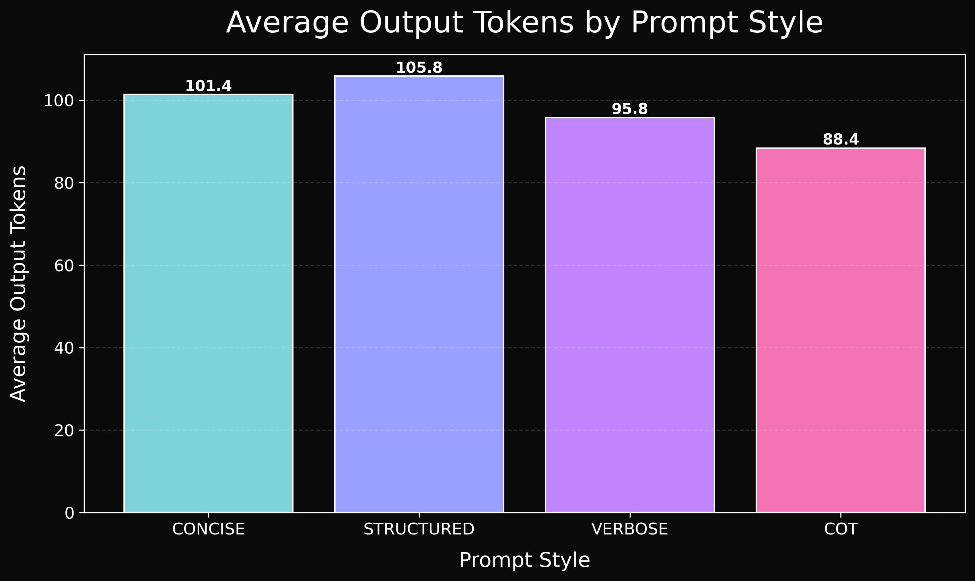
7. Average Output Tokens by Prompt Style
The highest number of output tokens are generated by structured type of prompts.
Chain-of-Thought prompts are the lowest.
Energy variation can be observed by seeing the difference between output length among different prompt styles.

Slide 8
8. Energy Prediction: Pre vs Post Inference
Model Type | R² | Meaning
Pre-run | 0.12 | Weak predictive power
Post-run | 0.999 | Near-perfect prediction
Pre-run models show weak predictive power (R² ≈ 0.13).
Post-run models achieve near-perfect accuracy (R² ≈ 0.999).
Runtime behavior (tokens & latency) determines energy.
Runtime features dominate prediction.

Slide 9
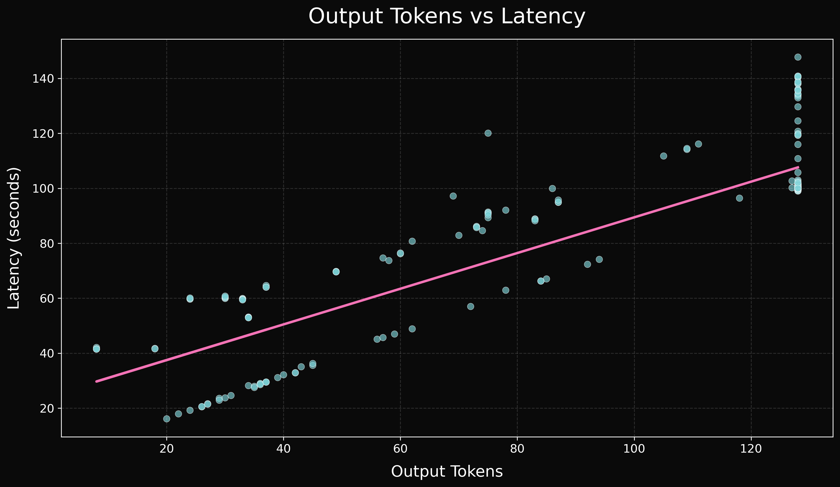
9. Regression Insights
From the regression analysis we can observe long outputs increase latency.
Latency, is the strongest predictor of energy usage.
This concludes runtime behavior, rather than prompt style alone, is the main factor for energy consumption.
Feature | Impact on Energy
latency_sec | Highest
output_tokens | High
Input_tokens | Low

Slide 10
10. Key Insight: How Prompt Design Impacts Energy
Initial hypothesis was that prompt style would affect energy directly.
But from the analysis and results we can observe, it is more of an indirect relation.
Prompt style changes how much output the model generates.
Long responses produce more output tokens.
And more output tokens increase the latency and computation.
Higher latency leads to higher energy consumption.
So prompt style affects energy indirectly through output length and runtime.

Slide 11
11. Conclusion
The main reason for energy use is output tokens.
Latency has a strong relationship with energy use.
Runtime behavior determines energy.
Prompt design doesn’t directly affect energy
Efficient prompts can help improve edge AI sustainability indirectly.

Slide 12
12. Future Work and Improvements
Improve pre-inference energy prediction models.
Test across additional Jetson power modes and clock speeds.
Analyze trade-offs between response quality and energy consumption.
Develop adaptive prompting strategies based on resource constraints.

Slide 13
13. References
E. J. Husom et al., “Sustainable LLM inference for edge AI: Evaluating quantized LLMs for energy efficiency, output accuracy, and inference latency,” arXiv, 2025.
M. Arya and Y. Simmhan, “Understanding the performance and power of LLM inferencing on edge accelerators,” arXiv, 2025.
E. J. Husom et al., “The price of prompting: Profiling energy use in large language models inference,” arXiv, 2024.
U. E. Dammu, “Energy efficiency in LLM inference: Open vs. closed models,” Regis University Practicum I, 2025.
ServiceNow, “REPLIQA dataset,” Hugging Face, 2024–2025.
corag, “MultiHopQA (HotpotQA configuration),” Hugging Face, 2025.
CCSum Team, “CCSum summarization dataset,” Hugging Face, 2024.
NVIDIA Corporation, “Jetson Nano Developer Kit Technical Reference Manual,” 2023.
F. Pedregosa et al., “Scikit-learn: Machine learning in Python,” JMLR, 2011.
TinyLlama Team, “TinyLlama-1.1B-Chat-v1.0,” Hugging Face Models, 2024.
OpenAI, “GPT-5 Pro and GPT-4.1 Mini large language models,” 2025. [Online]. Available: https://platform.openai.com

Slide 14
Thank you - Uttam Emmaniuel Dammu udammu@regis.edu https://github.com/emmaniuel26/Practicum-2

